Slide 1
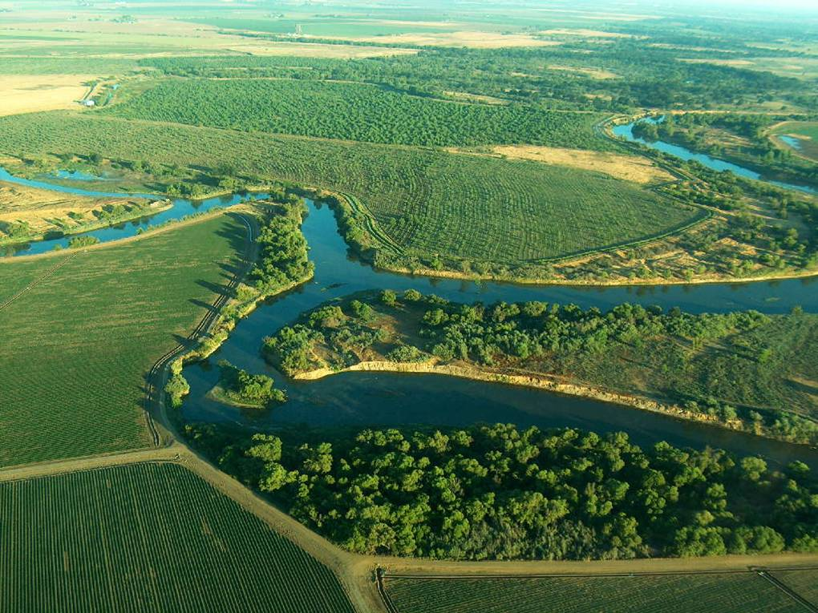
Three Amigos Non-Structural Alternative Update to the CVFPB August 28, 2015
Julie Rentner, Special Projects Director, River Partners
Paige Caldwell, Chief of the Readiness Section, US Army Corps of Engineers
Patrick Luzuriaga, Program Manager Flood Protection Corridor Program, DWR
Creating Wildlife Habitat for the Benefit of People and the Environment
Notes:
Intro
This is a follow-up to April presentation to the Board
Presentation includes: background with maps, progress reports organized by agency, timeline included in Board packet

Slide 2
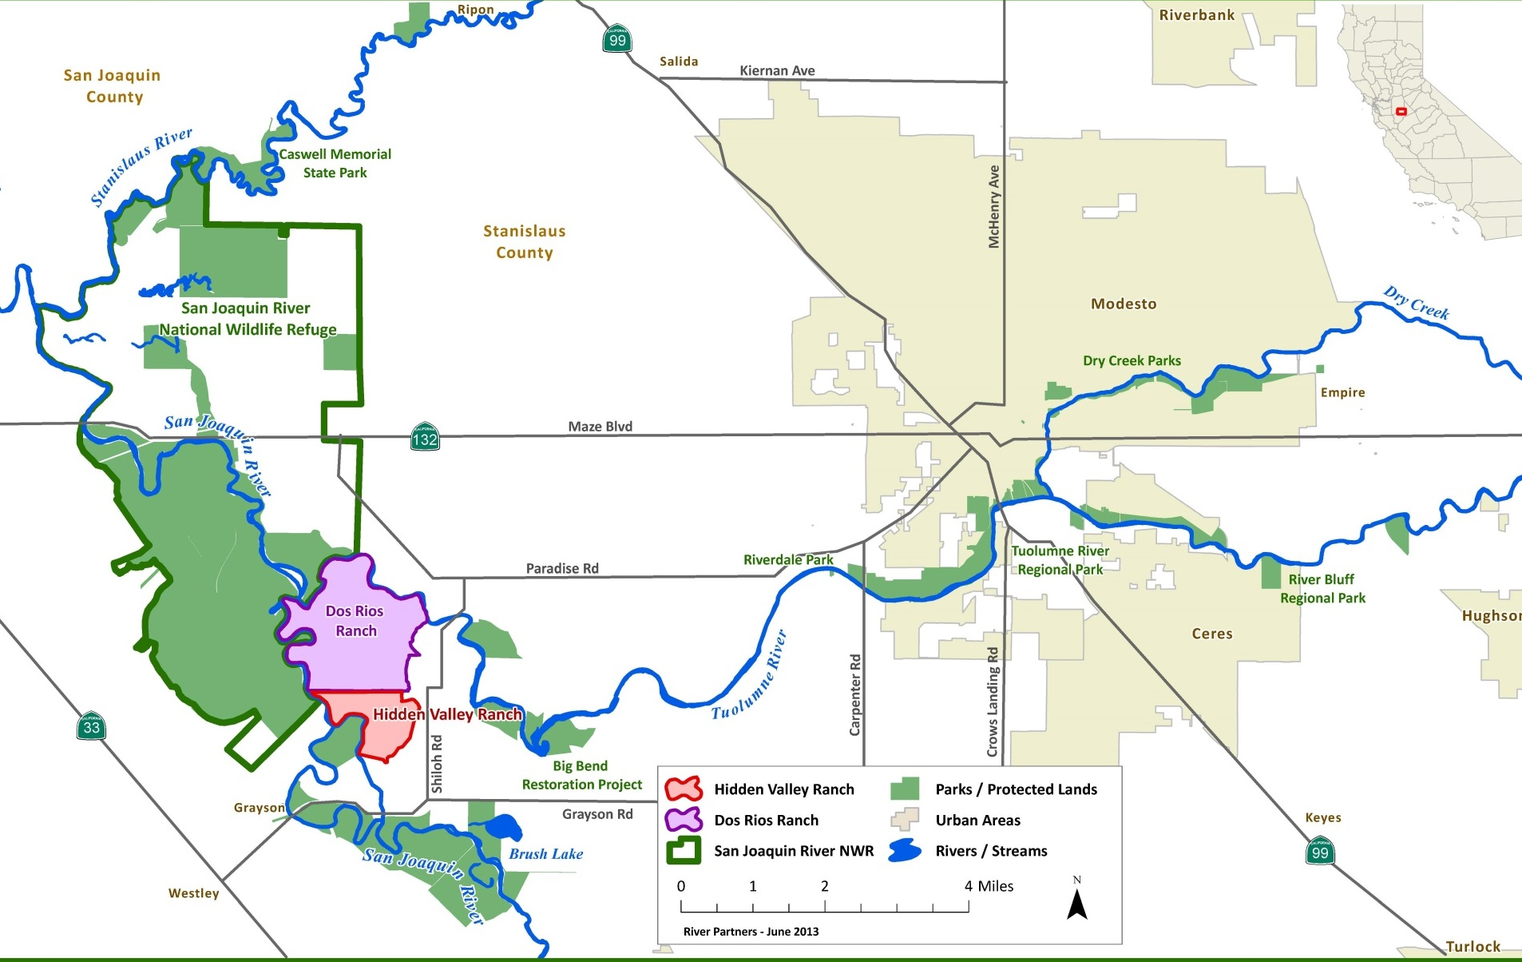
Three Amigos
Creating Wildlife Habitat for the Benefit of People and the Environment
Notes:
Location Map
Stanislaus County, 3166 acres adjacent to over 7,000 acre of additional wildlife habitat lands
Mid San Joaquin River Region
10 miles west of Modesto

Slide 3
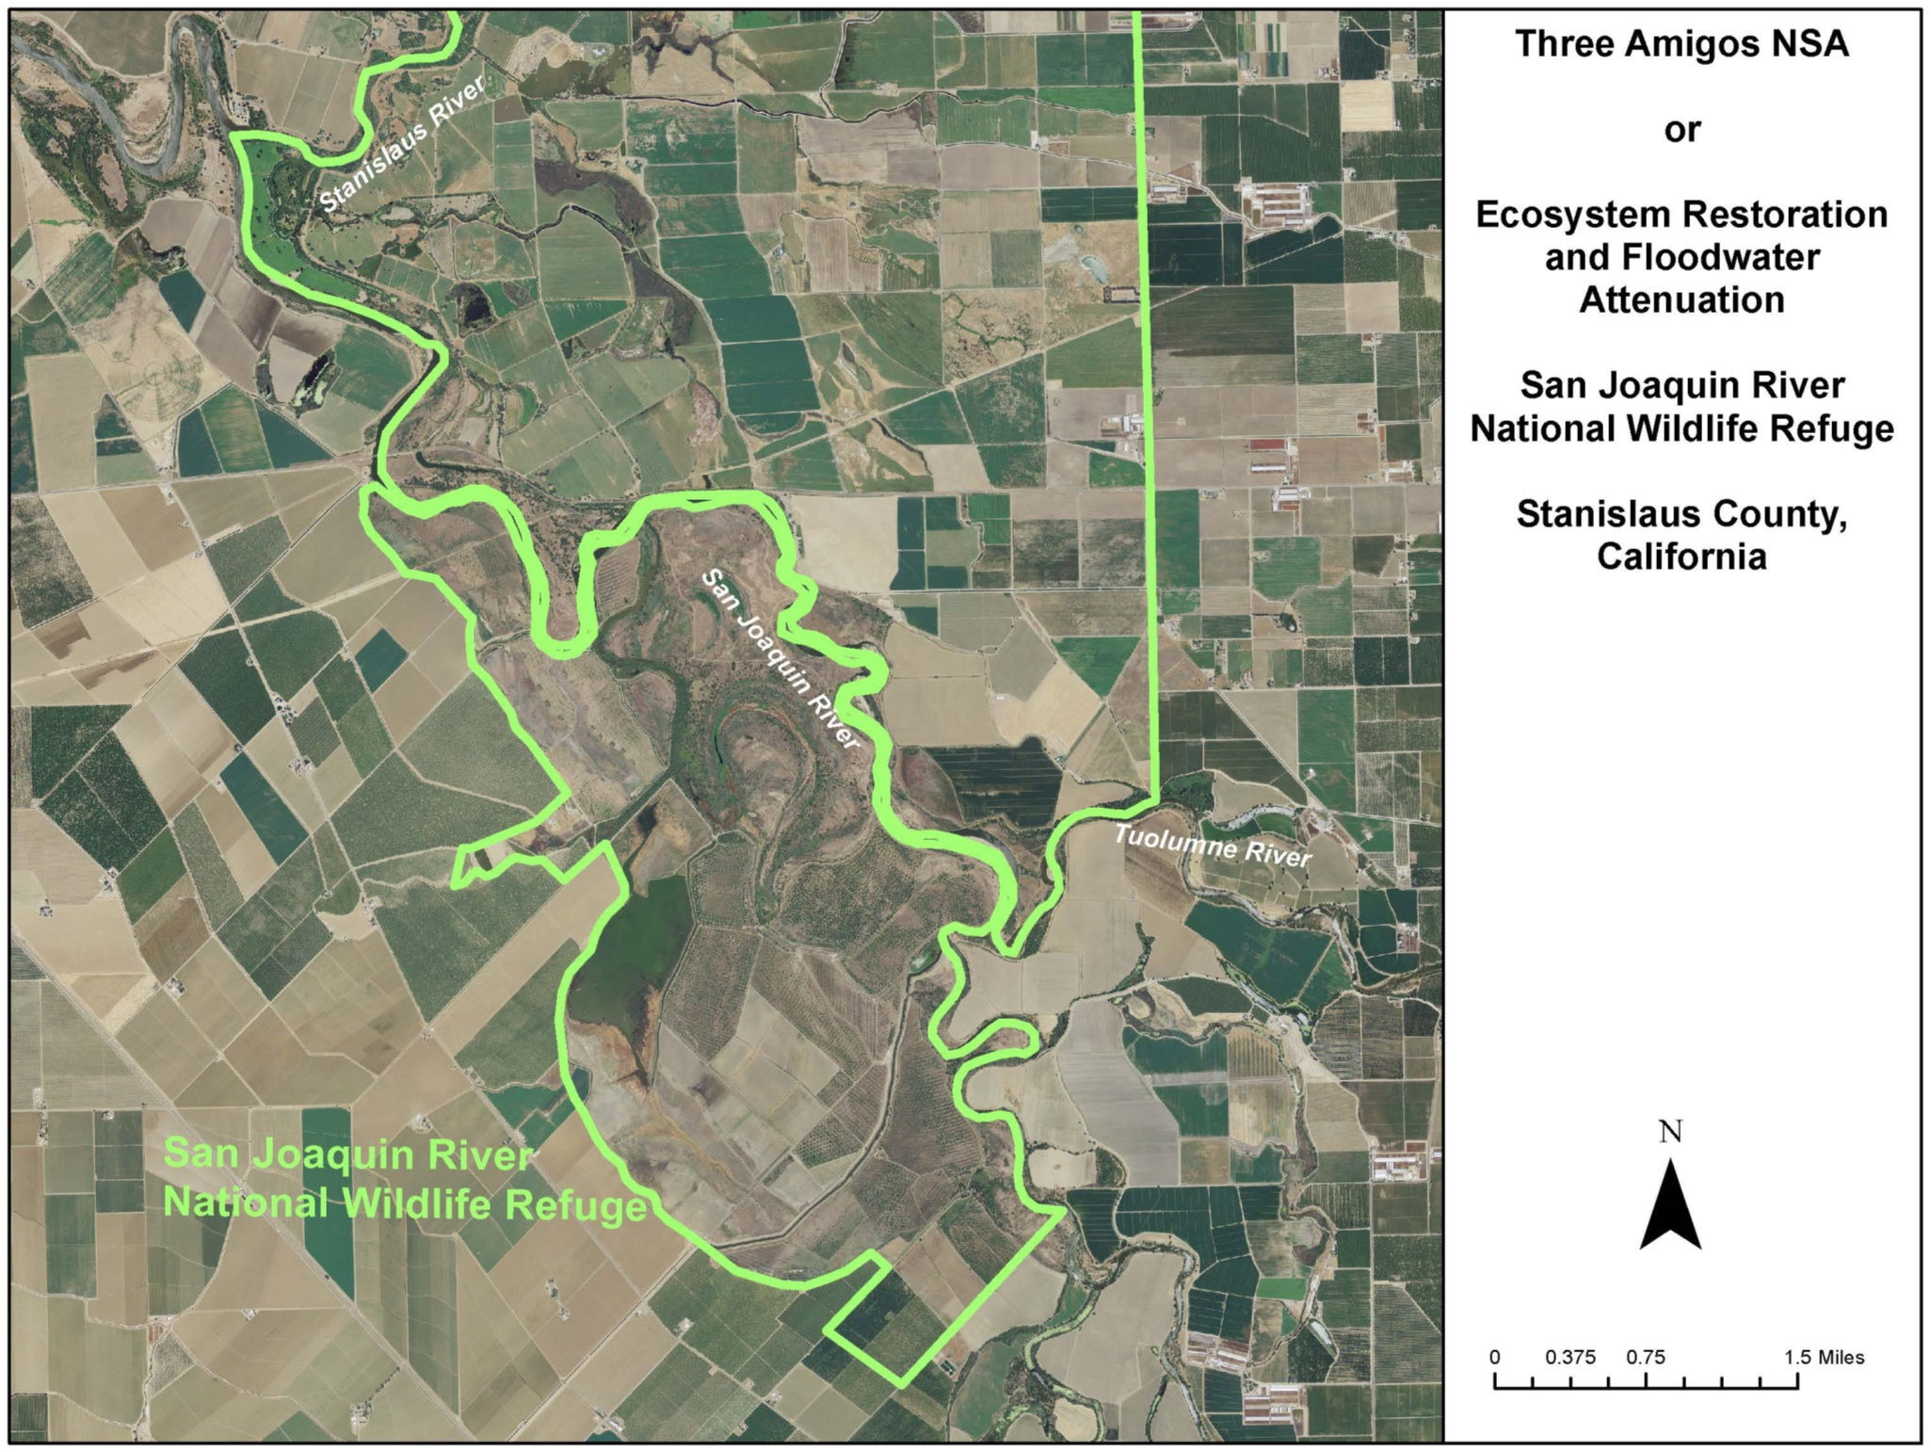
Creating Wildlife Habitat for the Benefit of People and the Environment
Notes:
Description of the landscape:
Largely agricultural around the Refuge, within the Refuge all lands have been restored to floodplain habitat types including seasonal and permanent wetlands, forests, shrublands, and flood refugia for terrestrial species
Over $40million in investment in habitat restoration supporting numerous special-status species including Riparian Brush Rabbit, riparian woodrat, least Bell’s vireo, and yellow warbler. Completion of this project will allow for reconnection of the restored habitats with floodwaters, and provide habitat benefits for salminds migrating through the San Joaquin and its tributaries. The acreage of floodplain foraging habitat that will be available to salmonids as a result of this project totals about 30% of the needed floodplain habitat calculated by the San Joaquin River Restoration Program upstream.

Slide 4
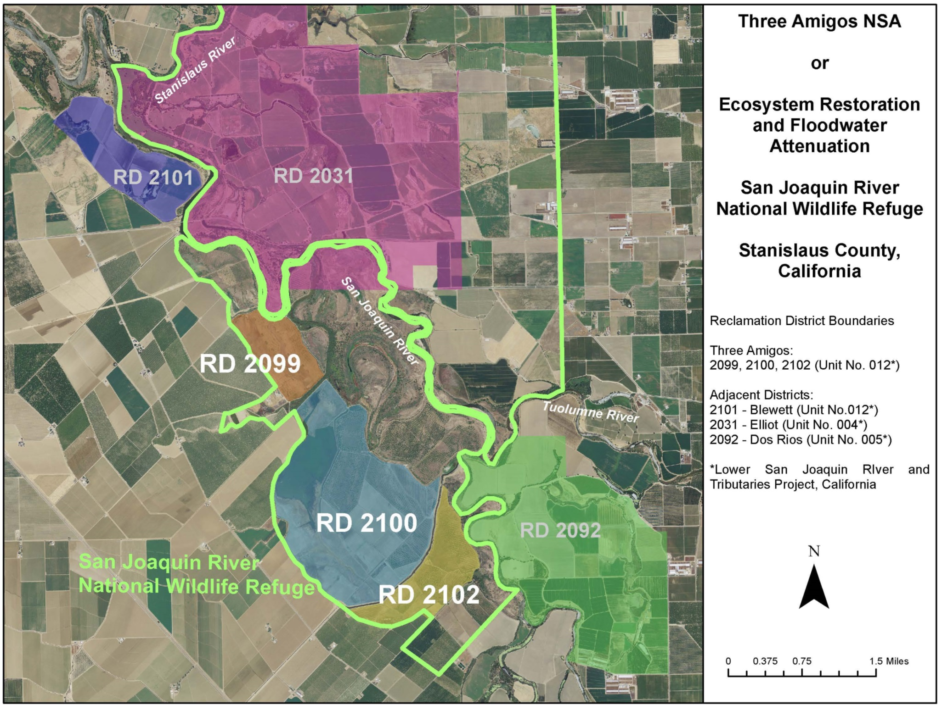
Creating Wildlife Habitat for the Benefit of People and the Environment
Notes:
Reclamation Districts and relationship to CVFPB and SPFC:
3 adjacent RDs: the “fourth amigo” 2101, Dos Rios Ranch 2092, and Faith and Mape’s Ranches which are largely managed in wildlife habitat and support a recovered population of Aleutian Cackling geese in seasonal wetlands and agricultural fields. This area comprises over 12 miles of the San Joaquin River between the confluences with two of its largest tributaries. It is immeditaely south of the Delta and about 20 miles north of the San Joaquin River Restoration Program’s area of interest.
The SPFC in this area is discontinuous including levee segments that tie into high ground at both ends. The purpose of the flood control project in this area is to protect agricultural lands behind the levees from flooding. The levees’ design level of flood protection is equal to about a 1 in 60-year flood event, above which these levees are overtopped.
The project is a high priority project in the Mid San Joaquin Regional Flood Management Plan, and similar habitat management and levee modification is proposed for adjacent lands within RD 2092.

Slide 5
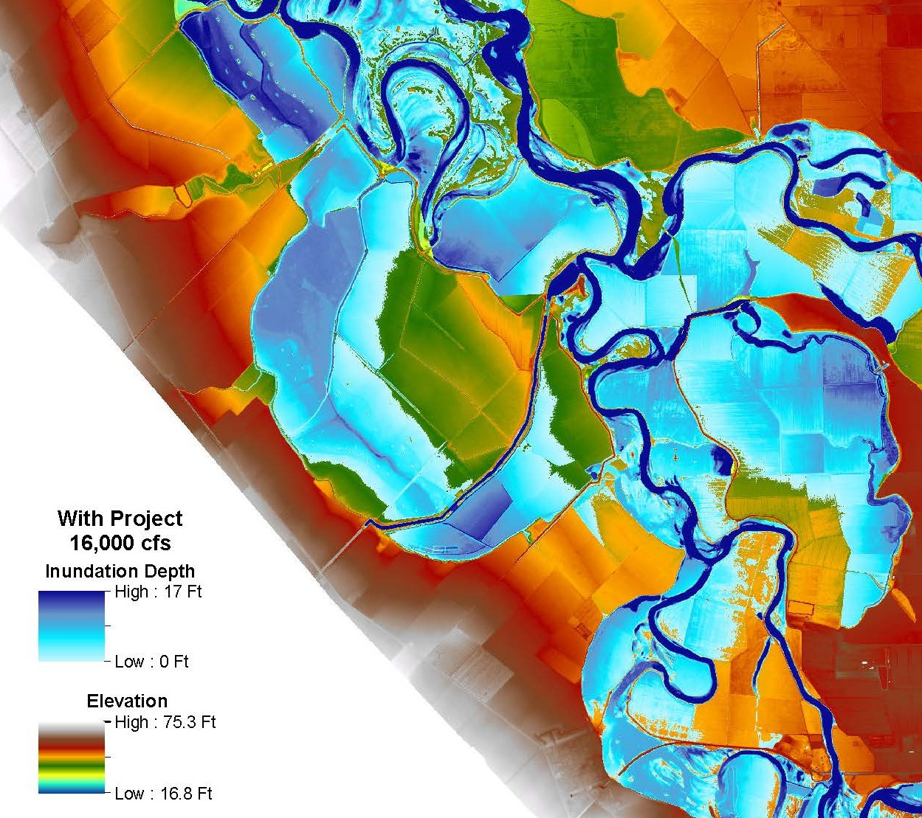
RD 2099
RD 2100
RD 2102
Creating Wildlife Habitat for the Benefit of People and the Environment
Notes:
Flood Modelling by DWR to support the 2017 CVFPP update

Slide 6
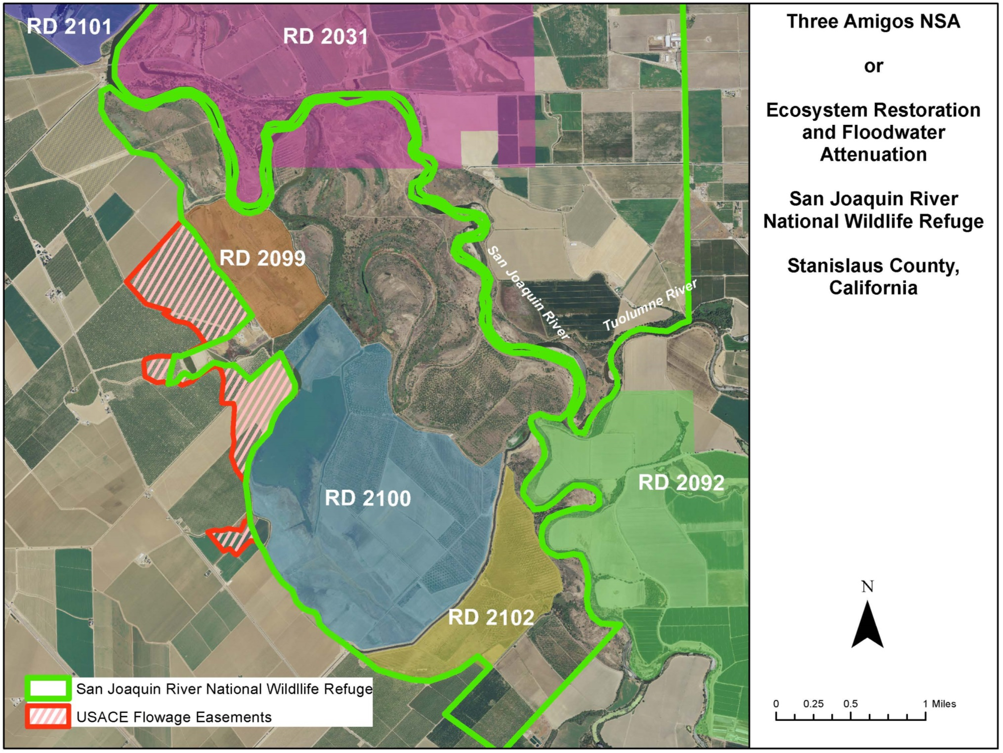
Creating Wildlife Habitat for the Benefit of People and the Environment
Notes:
Extent of Flooding as mapped by USACE – red thatched areas were identified in the USACE’s 1998 hydraulic analysis as being provided a flood benefit from the levees. Flowage easements are required to be purchased over these lands to mitigate potential flood impacts associated with the Three Amigos NSA. Paige will update the team on the progress.

Slide 7
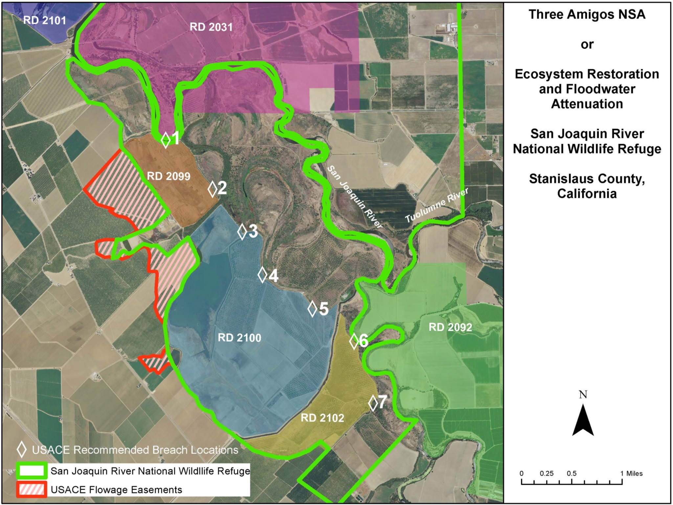
Creating Wildlife Habitat for the Benefit of People and the Environment
Notes:
Recommended Breach Locations – The USACE provided recommendations for levee breaching in their 1998 hydraulic analysis report. They are represented here. Currently, the project envisions modifying the levee are location #3 to promote drainage and reduce fish entrainment on the restored floodplain. All of these breach locations have been investigated in hydraulic analyses to determine optimal configurations for multiple benefits including habitat management and floodwater attenuation.

Slide 8
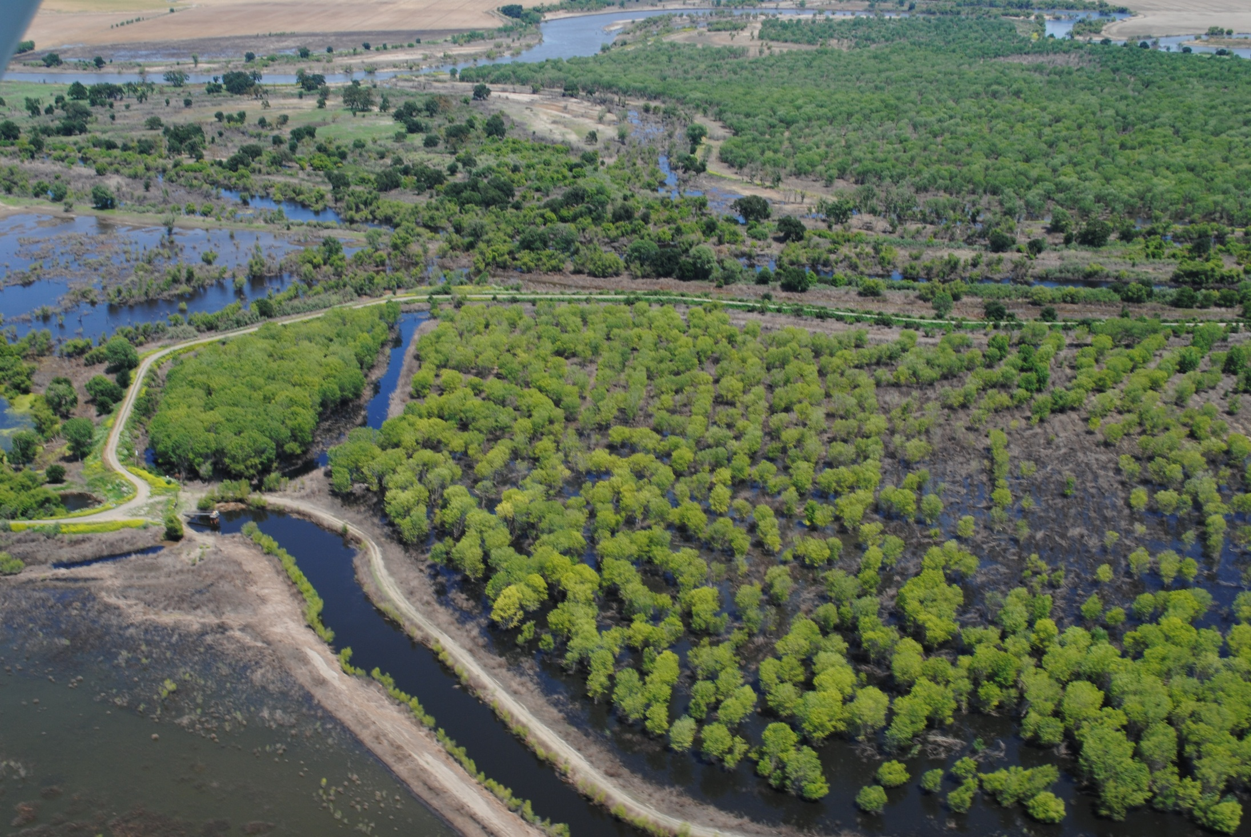
San Joaquin River
RD2100 Levee
N
Creating Wildlife Habitat for the Benefit of People and the Environment
Notes:
Habitat restoration and land management – since 2002, USFWS has been working with partners to design and implement habitat restoration across the 3 amigos lands in anticipation of completion of the paperwork. In 2006, floodwaters were impounded behind the levee and we observed damage to the restored habitat as a result of high water temperatures and poor drainage. Presumably there were also fish entrainment losses associated with this event. This event drove the USFWS to partner with River Partners and DWR to seek funding to complete the Three Amigos project and improve drainage at the site.

Slide 9
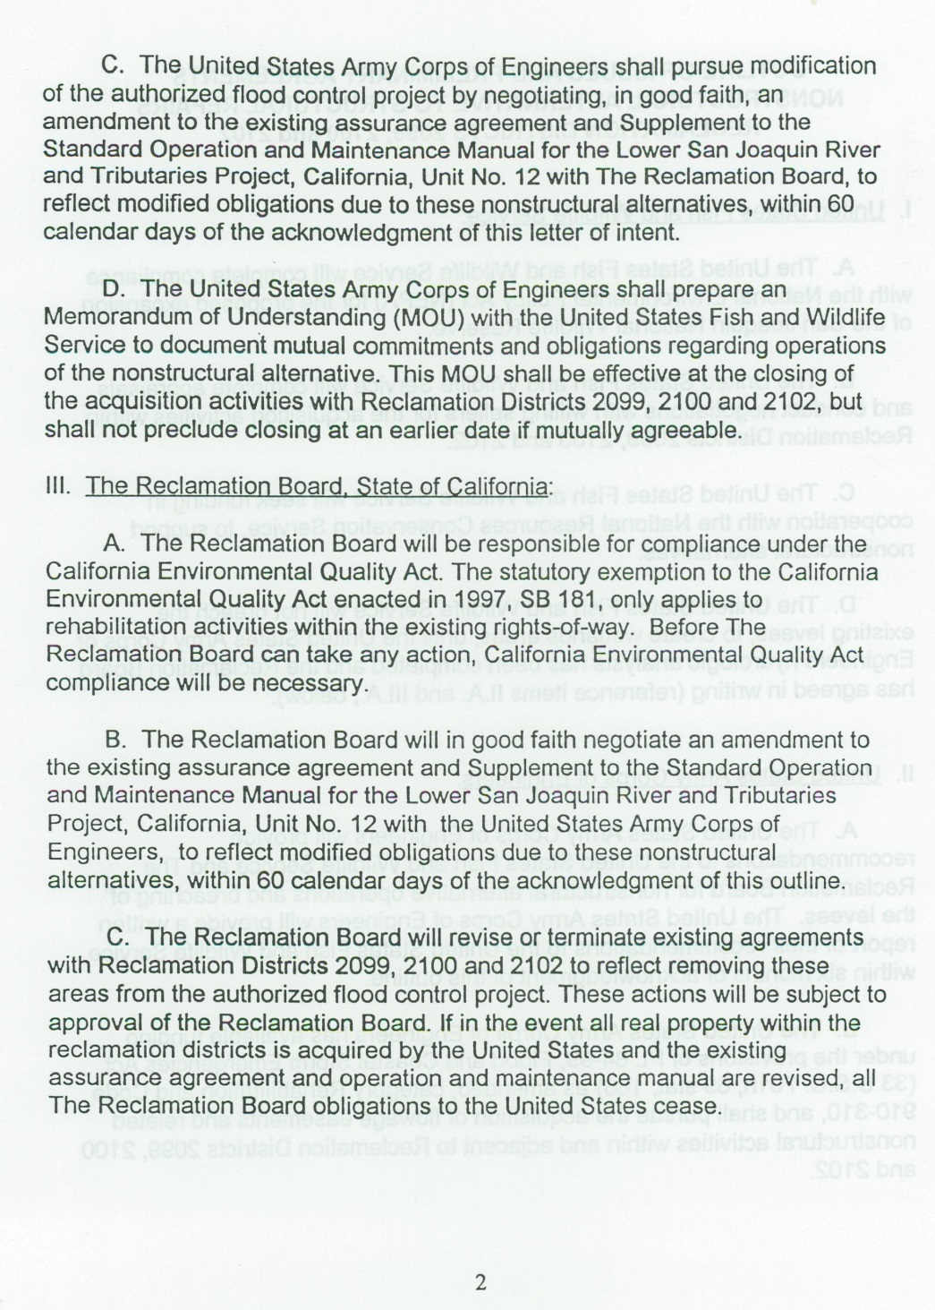
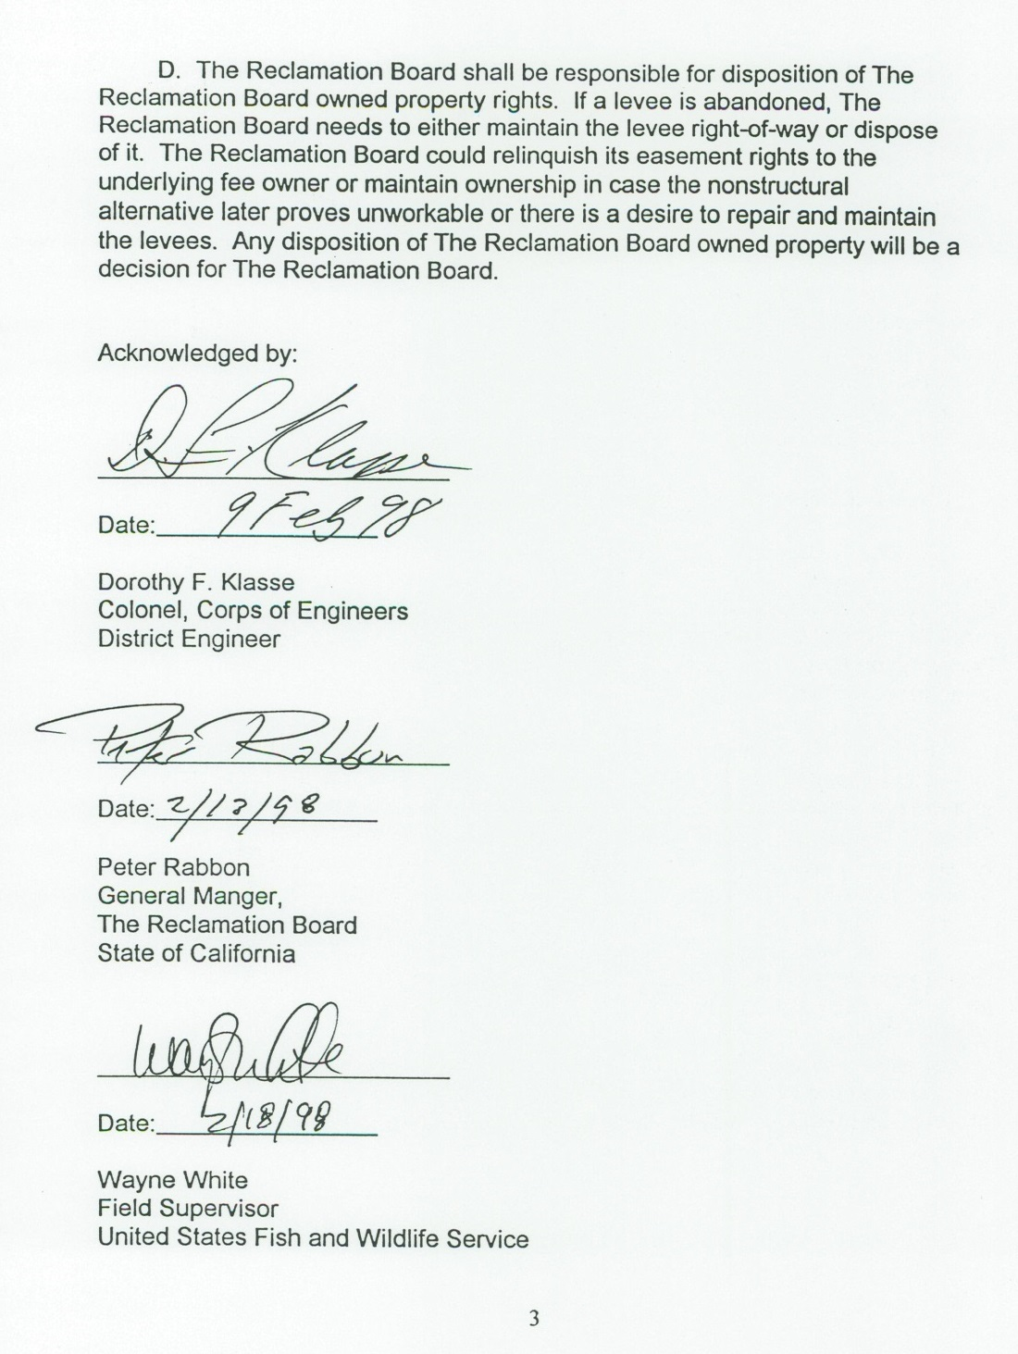
Creating Wildlife Habitat for the Benefit of People and the Environment
Notes:
Agreements and Responsibilities
This document has been provided to Board members in past hearings. In 1998, the three agencies (Board, USACE and USFWS) signed an agreement to work collaboratively to implement this project. This 1998 agreement is the framework that the team has been using to chart a pathway forward. The next slides provide a summary of each agency’s progress to date and next steps.

Slide 10
USFWS progress update
Completed land acquisition and NEPA for inclusion of the 3 Reclamation Districts in the San Joaquin River National Wildlife Refuge
Completed habitat restoration on the 3 Reclamation District lands in anticipation of breaching the levees
Creating Wildlife Habitat for the Benefit of People and the Environment
Notes:
Progress made to date by USFWS – presented by JR

Slide 11
Next Steps: USFWS
Release USACE from ring levee obligation
Execute Maintenance Agreement with USACE
Work with River Partners and DWR on Encroachment Permit Application for levee modification: drainage pipes at recommended breach location #3
Creating Wildlife Habitat for the Benefit of People and the Environment
Notes:
Next steps for USFWS – presented by JR

Slide 12
Notes:
Progress made to date by DWR, next steps

Slide 13
Notes:
Progress made to date by DWR, next steps

Slide 14
Notes:
Progress made to date by USACE, next steps

Slide 16
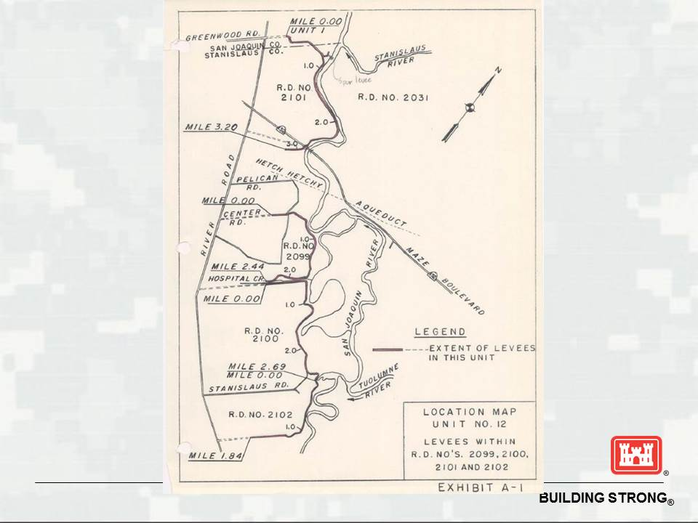

Slide 18
CVFPB progress update
Completed Preliminary Real Estate Review for Sacramento San Joaquin Drainage District (SSJDD) Easements
Hosted planning meetings for stakeholders October 2014, April 2015, July 2015 and developed timelines and project approaches
Creating Wildlife Habitat for the Benefit of People and the Environment
Notes:
Progress made to date by CVFPB

Slide 19
CVFPB next steps
Staff to prepare recommendations regarding:
SSJDD property disposal or maintenance
Dissolution of maintenance assurance agreements with RDs 2099, 2100 and 2102
CEQA Responsible Agency Findings
Staff to present these recommendations to the Board
Board to consider Resolution prepared by staff and accept the modified O&M Manual prepared by USACE
Pending task completion, anticipate Board action at CVFPB meeting on December 18, 2015
Creating Wildlife Habitat for the Benefit of People and the Environment
Notes:
Next steps for CVFPB

Slide 20
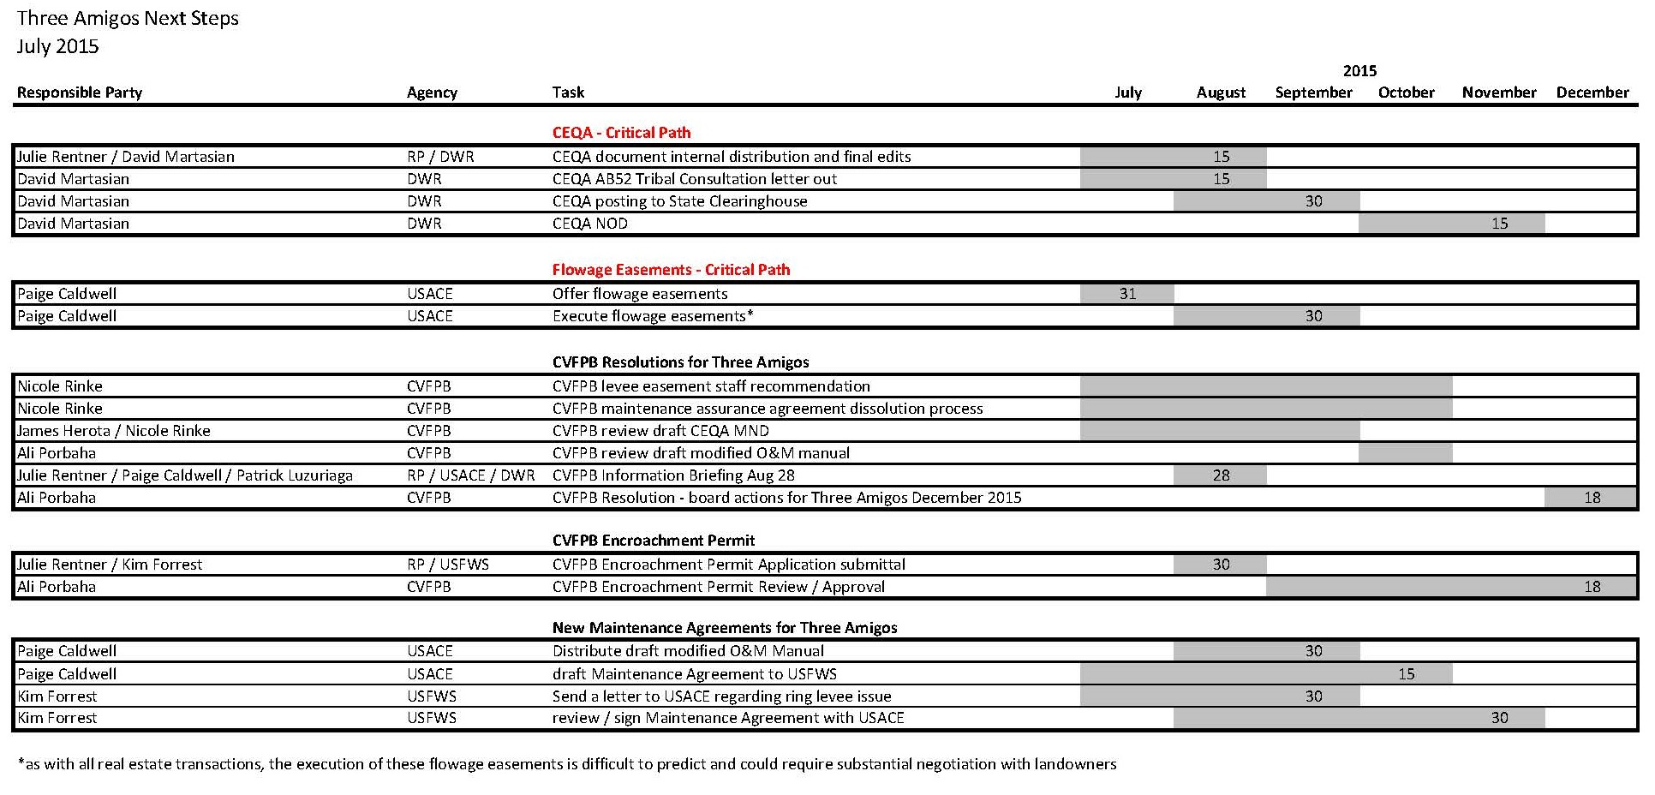
Creating Wildlife Habitat for the Benefit of People and the Environment
Notes:
Timeline and responsibilities
This timeline is attached to the Board item. JR will go through it and address any questions the Board might have on it.

Slide 21
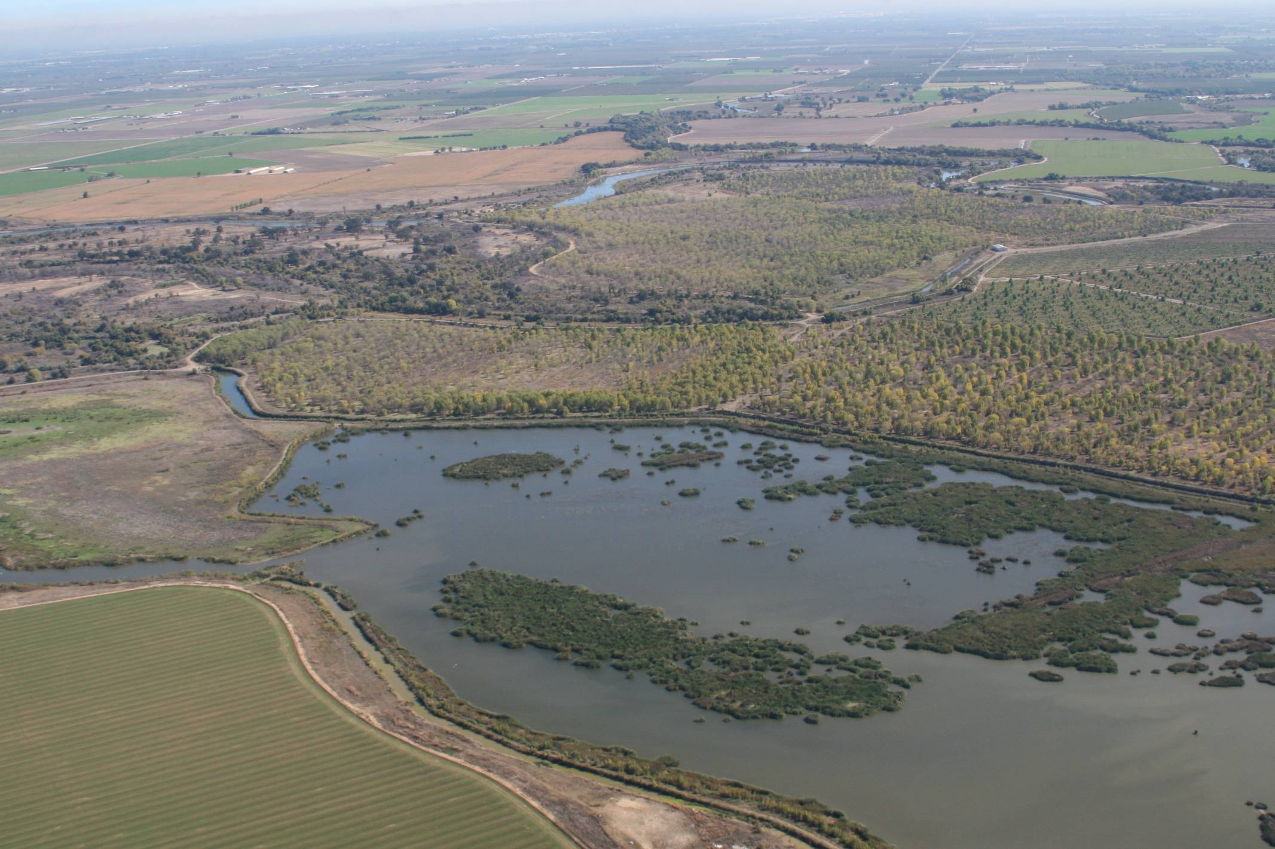
Questions?
Creating Wildlife Habitat for the Benefit of People and the Environment
Notes:
Questions?

